Slide 1
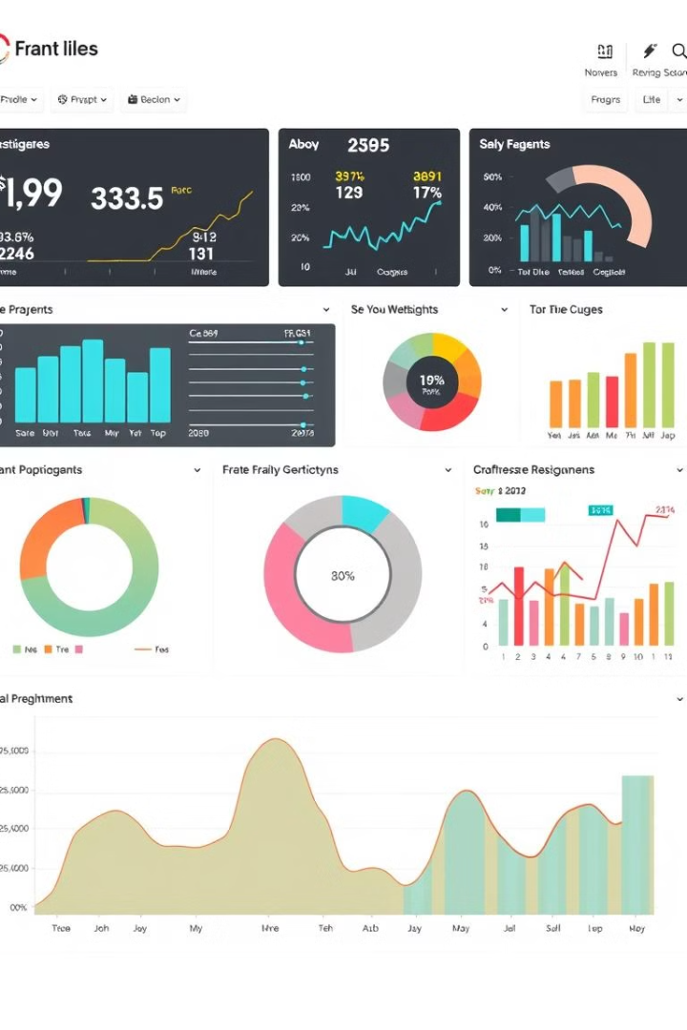

A prototype of BI system CRUD and visualization
Product Mix
By Group 2

Slide 2

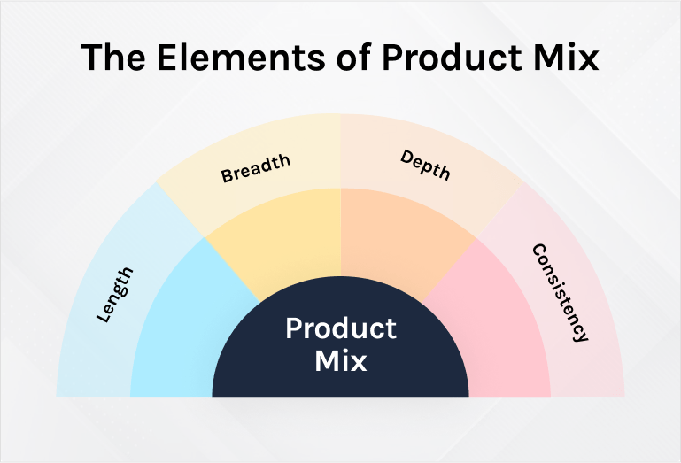



What is product mix?
Width
Refer to the number of product lines ordered by a company.
Length
Refer to the number of products in firm’s product mix.
Depth
Refer to the number of variations within a product line.
Consistency
Refer to how closely related product lines are to each other.

Slide 3




Benefits of Product mix analysis
Emerging Markets
Consumer Preferences
Technological Advancements
Identify new markets with potential for expansion.
Track changing consumer tastes and preferences.
Explore new product categories .

Slide 4

Problem Statement
How to optimize a business's product portfolio based on…
1
Profit
2
Revenue.
3
Manufacturing cost
4
Number of products sold

Slide 5
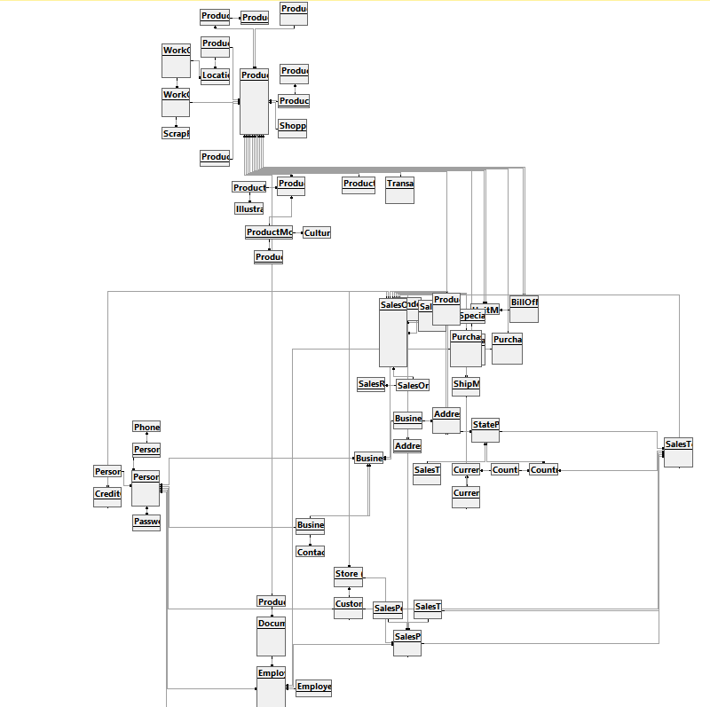
Analyze source data for building BI system
1
Characteristics
2
Purpose
Data is clearly designed and closely linked together. But it also have some Null value,…
Data provides information about the market, customers,.
3
Detail
4
Data Quality
72 tables with 6 schema, 20 views and 10 procedures .
Suitable for product mix analysis.

Slide 6
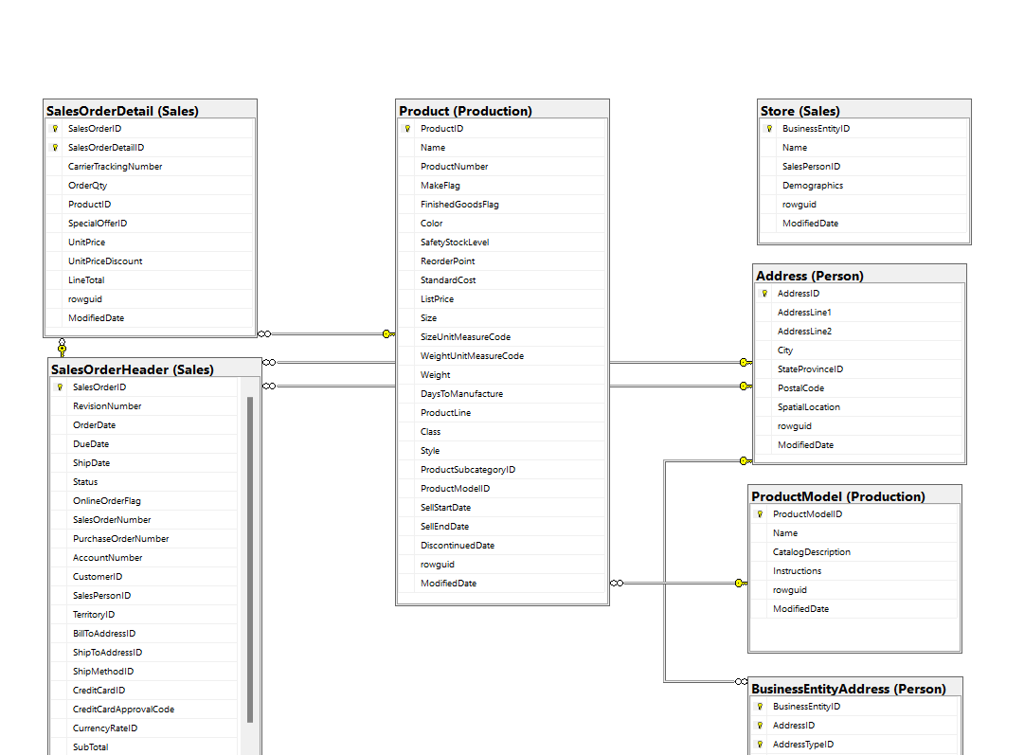
Analytics Database Design

Slide 7
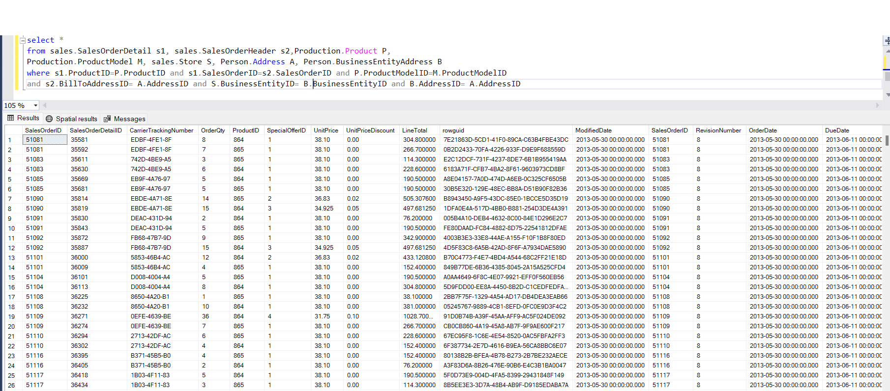
Analytics Database Design

Slide 8
What is ETL and why is it important for BI?
ETL: Extract, Transform, Load
Importance for BI
ETL is the process of extracting data from multiple sources, transforming it into a format suitable for analysis, and loading it into a data warehouse or data lake.
ETL pipelines are essential for BI because they provide a consistent and reliable source of data for business insights and decision-making.

Slide 9





ETL (Extract-Transform-Load) Pipeline Implementation
1
Data Sources
2
Data Extraction
3
Data Transformation
4
Data Loading
5
Data Warehouse/Lake

Slide 10




Tools and Technologies for ETL Pipelines
Apache Spark
Cloud-Based Services
A fast and scalable engine for batch and real-time processing.
Solutions like Snowflake, Amazon Redshift, and Google BigQuery.
ETL Pipelines as Code
Use tools like Apache Airflow for defining, scheduling, and managing pipelines.

Slide 11
What is SSIS?
Data Integration Tool
ETL Processes
SSIS is a component of Microsoft SQL Server that allows users to create data integration solutions. It's used to move, transform, and load data from various sources to target destinations.
SSIS is designed to handle Extract, Transform, and Load (ETL) operations. This involves extracting data from sources, cleaning and manipulating it, and loading it into data warehouses or other systems.

Slide 12
Benefits of Using SSIS for ETL
1
Improved Efficiency
2
Enhanced Data Quality
SSIS automates data integration tasks, freeing up time and resources for other critical operations.
SSIS provides tools for data cleansing and transformation, ensuring high-quality data for analysis and reporting.
3
Scalability and Flexibility
4
Cost-Effective Solution
SSIS packages can be scaled to handle large volumes of data and can adapt to changing data requirements.
SSIS is included with SQL Server, making it a cost-effective solution for data integration compared to third-party tools.

Slide 13





SSIS Components and Architecture
Data Sources
Transformations
Data Destinations
Control Flow
SSIS connects to various data sources, including relational databases, flat files, XML files, and more.
SSIS offers a wide range of transformations for cleaning, manipulating, and enriching data.
SSIS loads data into different destinations, such as databases, flat files, or other applications.
The Control Flow defines the execution order of tasks, manages error handling, and controls package execution.

Slide 14




Designing SSIS Packages
Define Requirements
1
Start by clearly defining the source data, transformations, and target destination.
Create Control Flow
2
Design the execution order of tasks using SSIS tasks and control flow elements.
Build Data Flow
3
Connect sources, transformations, and destinations to create a data flow path.
Test and Deploy
4
Thoroughly test the package in different environments to ensure correct functionality.

Slide 15

Executing SSIS Packages
Manual Execution
Event-Based Execution
Packages can be run manually through SSIS Designer or SQL Server Management Studio.
Packages can be triggered by events, such as database changes or file updates, providing real-time data integration.
1
2
3
Scheduled Execution
SSIS allows packages to be scheduled for regular execution, automating data integration tasks.

Slide 16
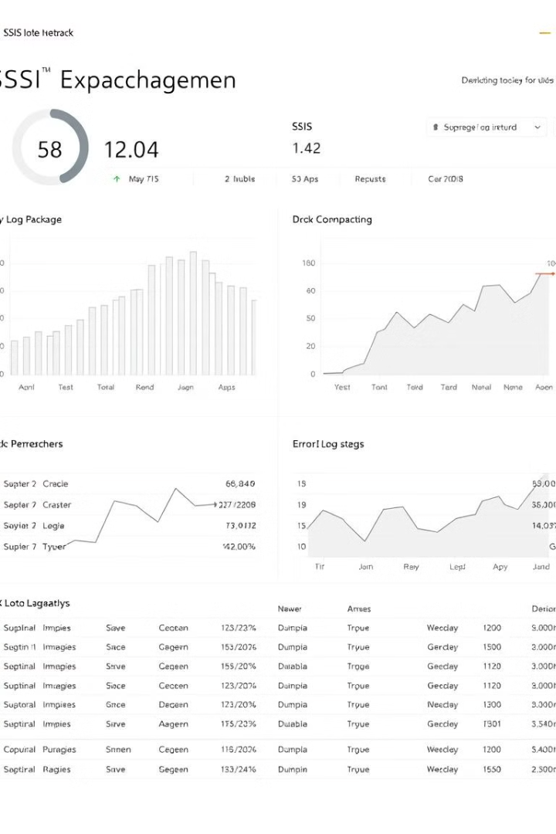



Monitoring and Troubleshooting SSIS
Monitoring Tools
SSIS provides built-in monitoring features, and third-party tools offer enhanced monitoring capabilities.
Error Handling
SSIS allows for error handling, ensuring that packages gracefully manage exceptions and failures.
Log Management
SSIS packages generate logs that record execution details, errors, and performance metrics.

Slide 17
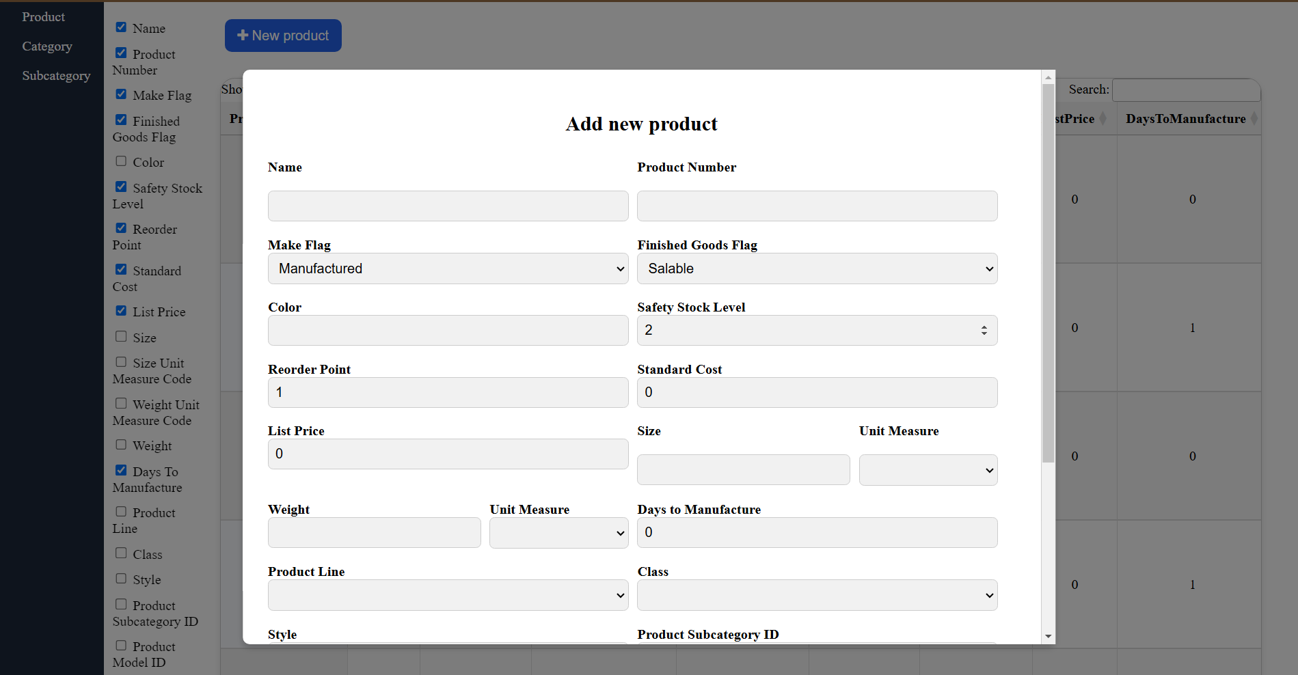
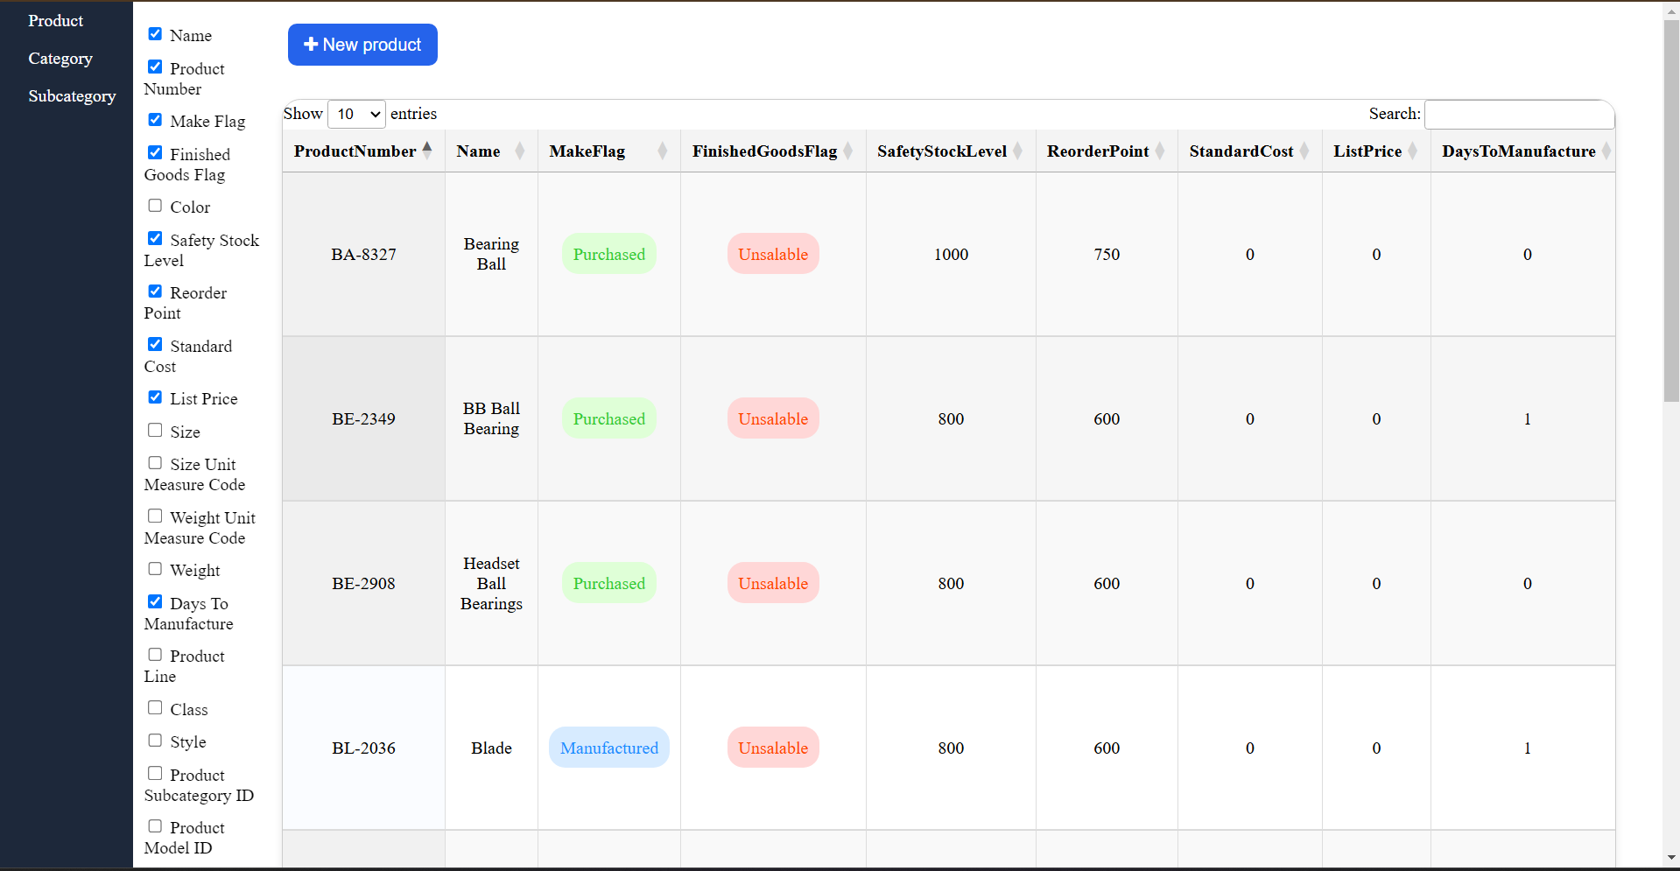
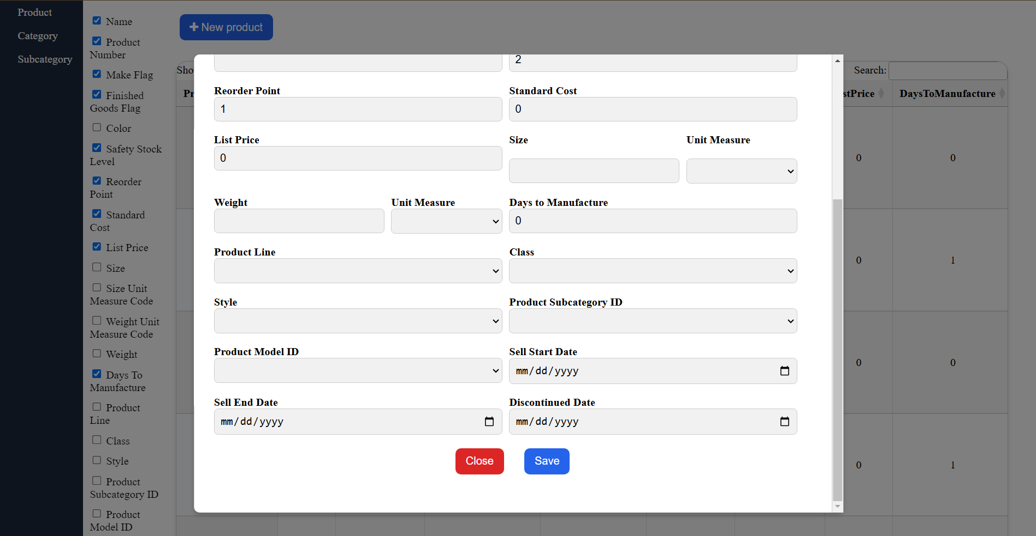
Application Design and Development with Minimum CRUD

Slide 18
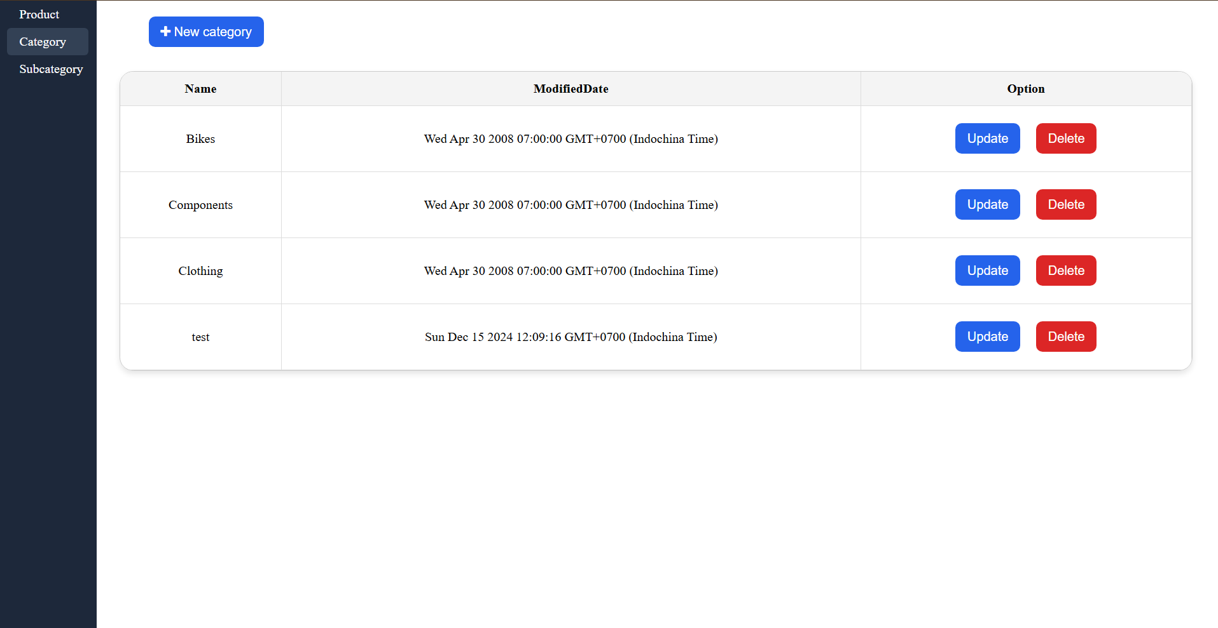
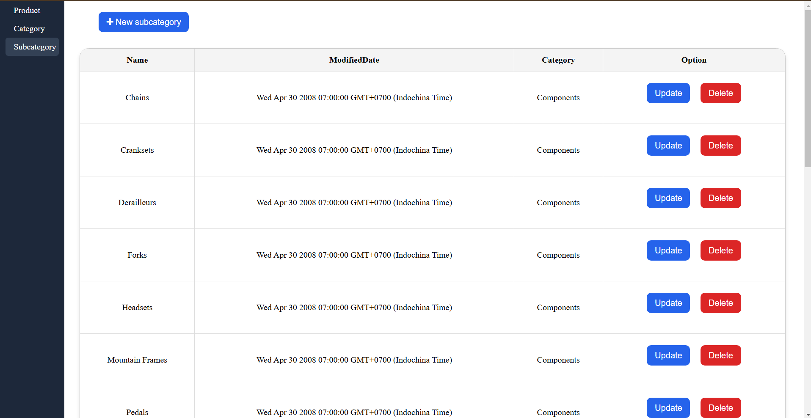
Application Design and Development with Minimum CRUD

Slide 19
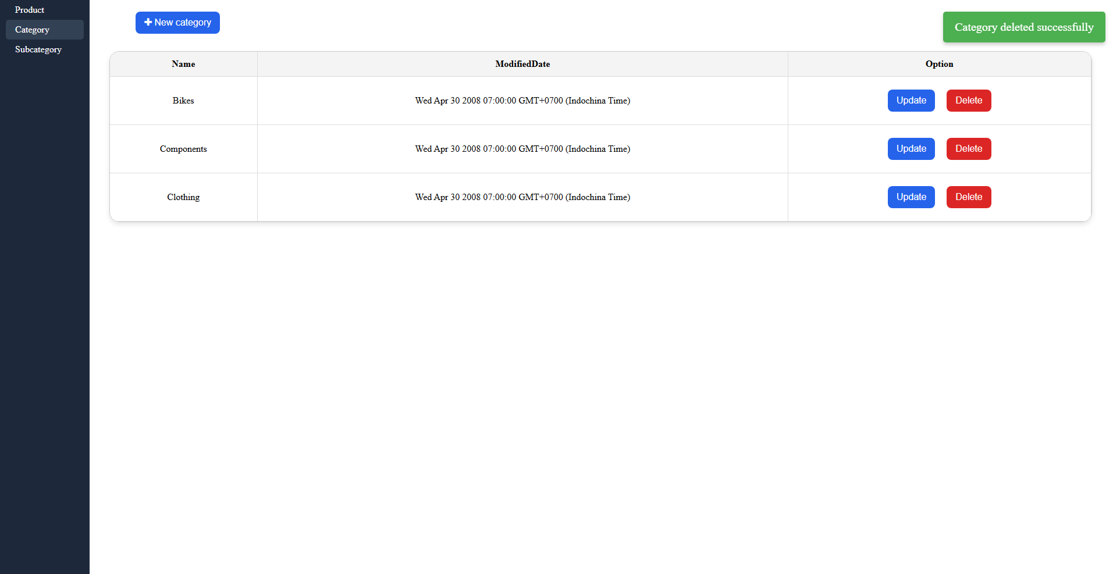
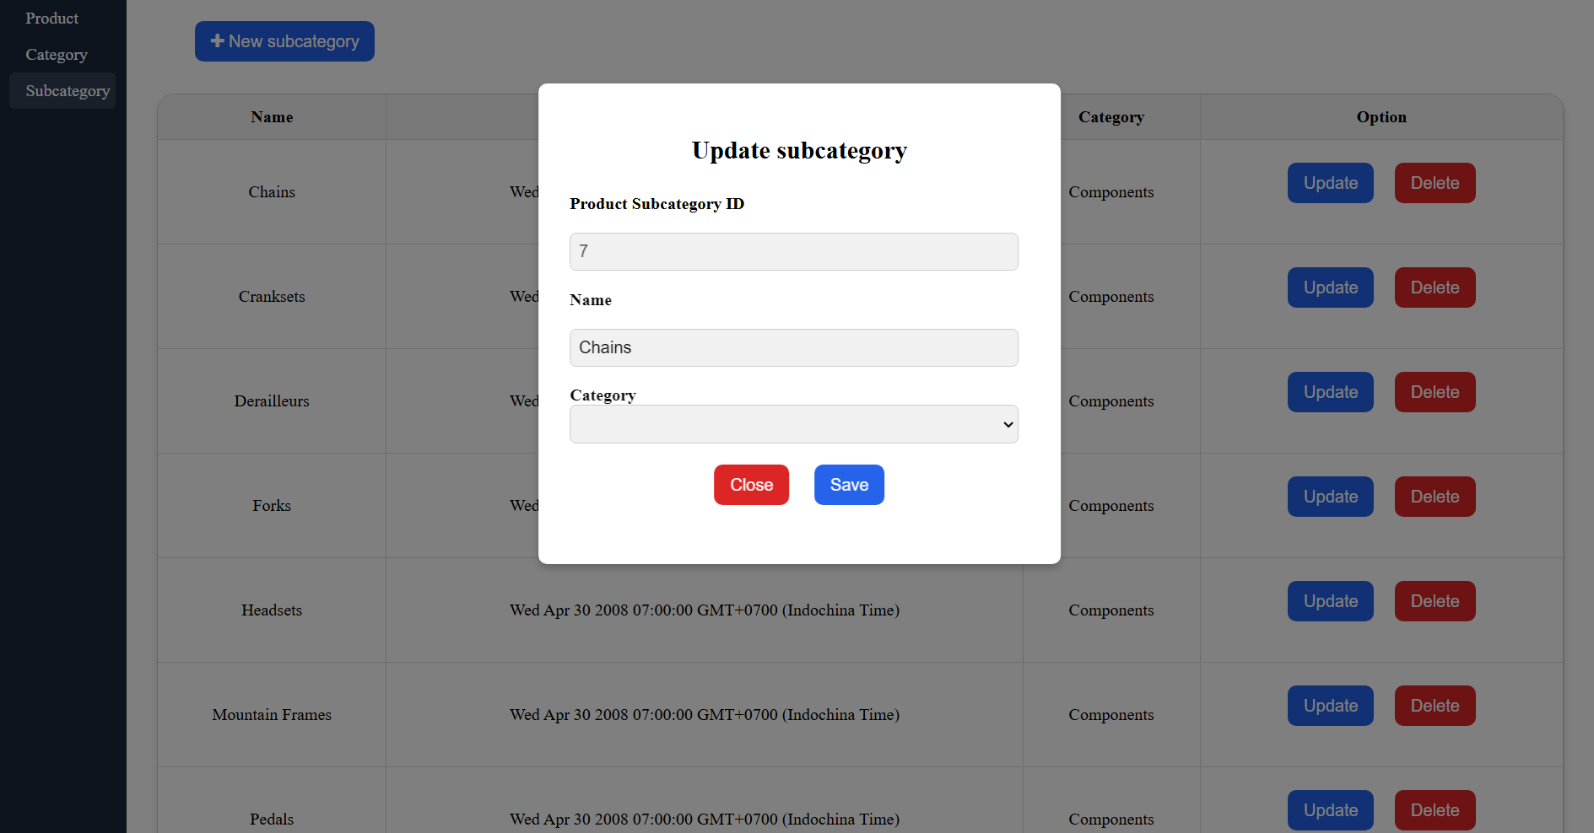
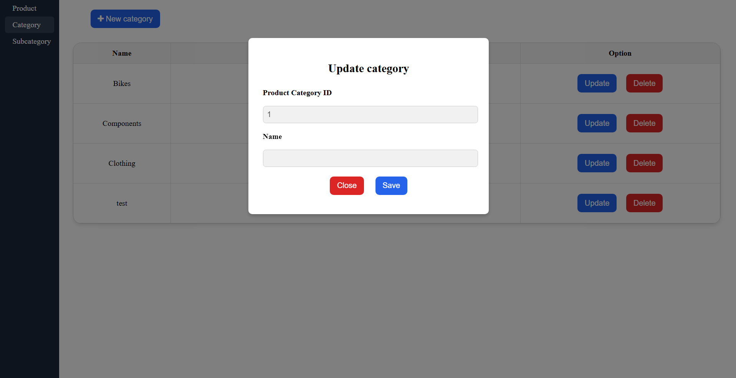
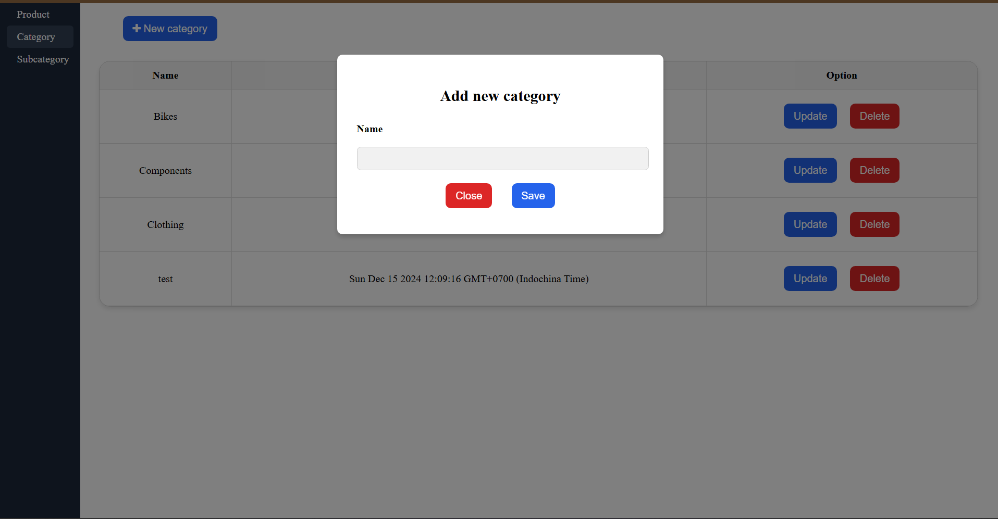
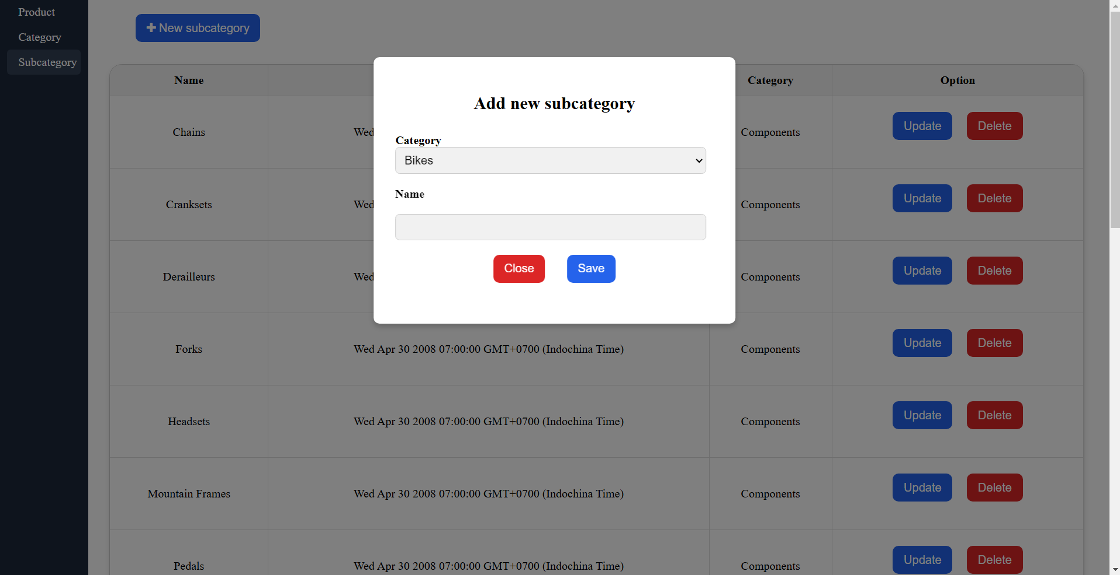
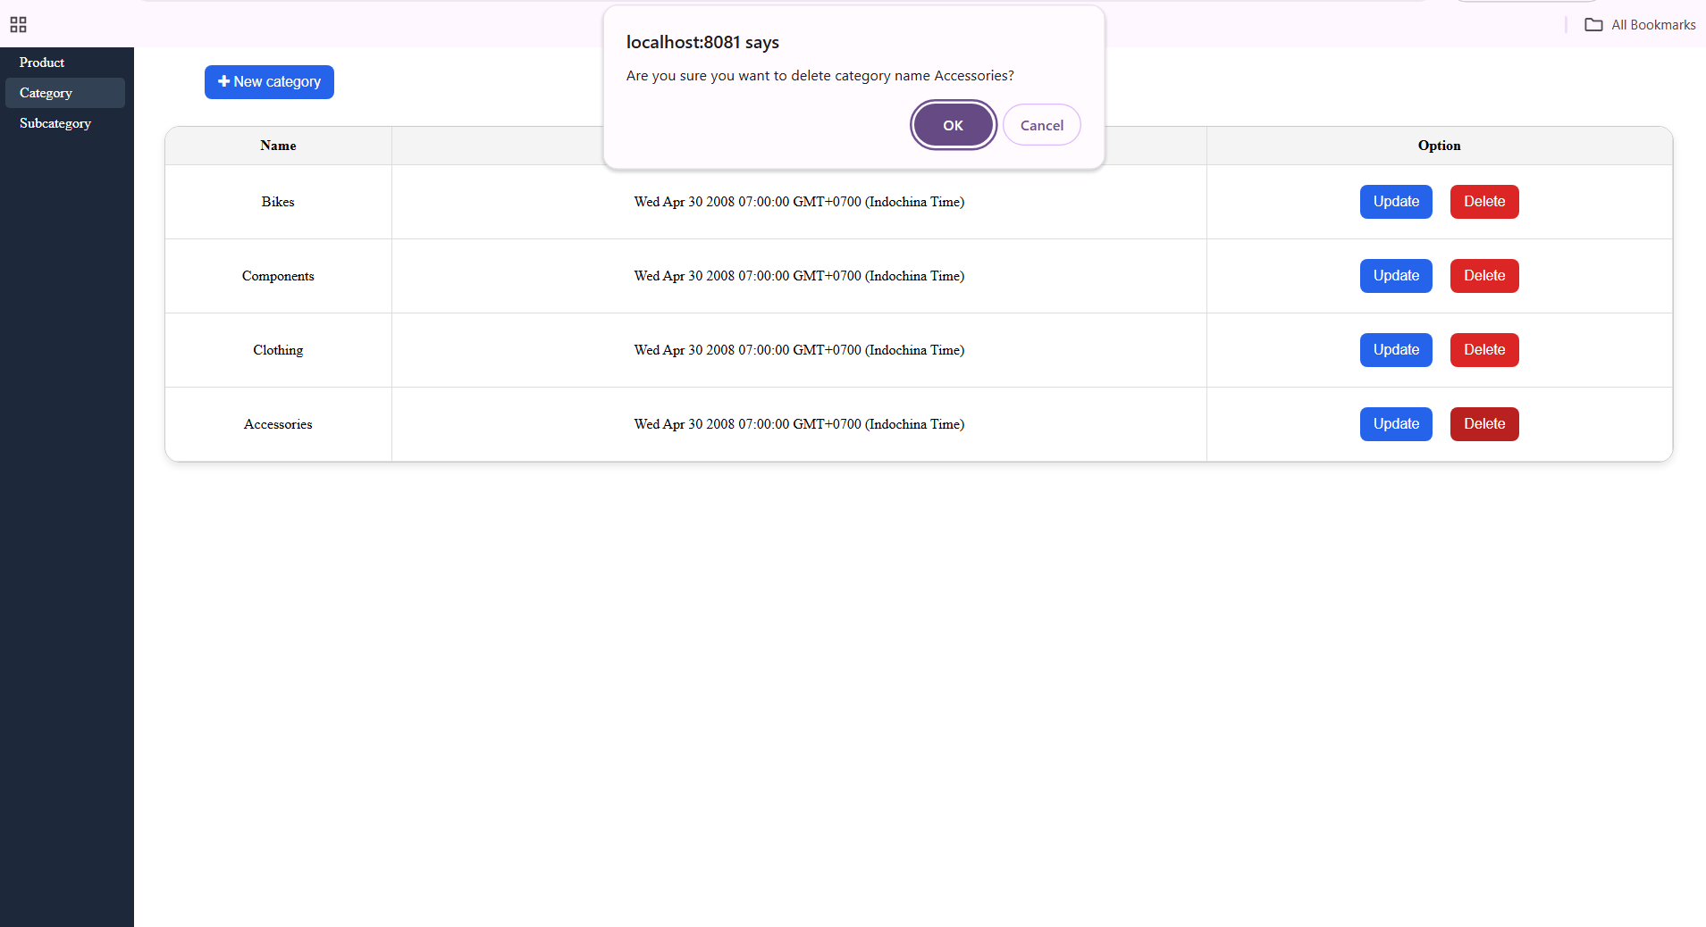
Application Design and Development with Minimum CRUD

Slide 20
Visualization
Unlocking Insights
Effective Communication
Enhanced Decision-Making
Transforms raw data into meaningful and easily understandable visuals, revealing hidden patterns and trends.
Simplifies complex data, making it accessible to diverse audiences, facilitating communication and collaboration.
Provides a visual context for informed decision-making, enabling faster and more accurate analysis.

Slide 21





Introduction to Power BI
Self-Service BI
1
Empowers business users to analyze and visualize data without relying on IT.
2
Data Connectivity
Connects to various data sources, including databases, spreadsheets, and cloud services.
3
Interactive Dashboards
Creates interactive dashboards that allow users to explore data and filter visualizations.
4
Collaboration and Sharing
Enables easy sharing of reports and dashboards across teams and organizations.
5
AI-Powered Insights
Leverages AI capabilities to identify patterns, trends, and anomalies in data.

Slide 22
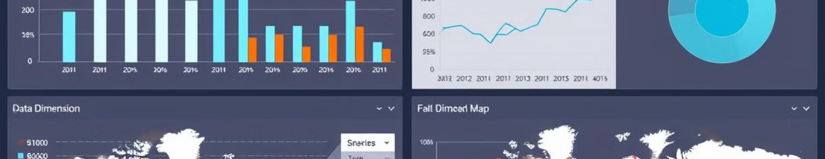




Power BI Visualization Techniques
Bar Charts
Line Charts
Pie Charts
Maps
Compare categories or values across time periods.
Show trends and patterns over time.
Display proportions or percentages of a whole.
Visualize geographical data, highlighting locations and patterns.

Slide 23
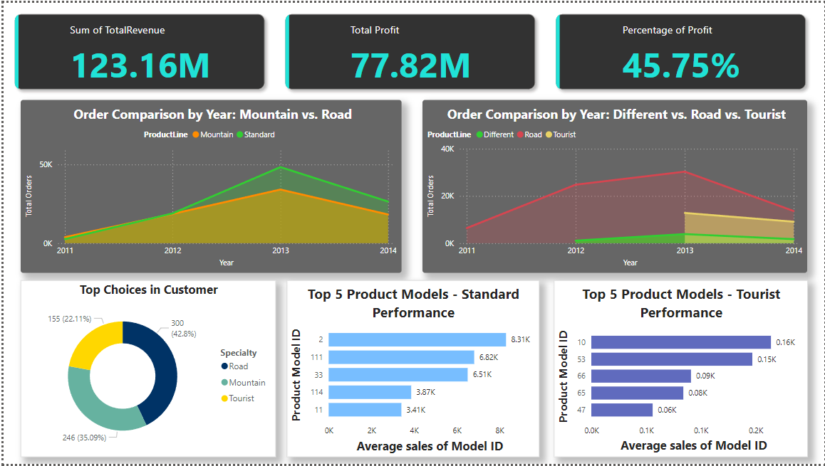
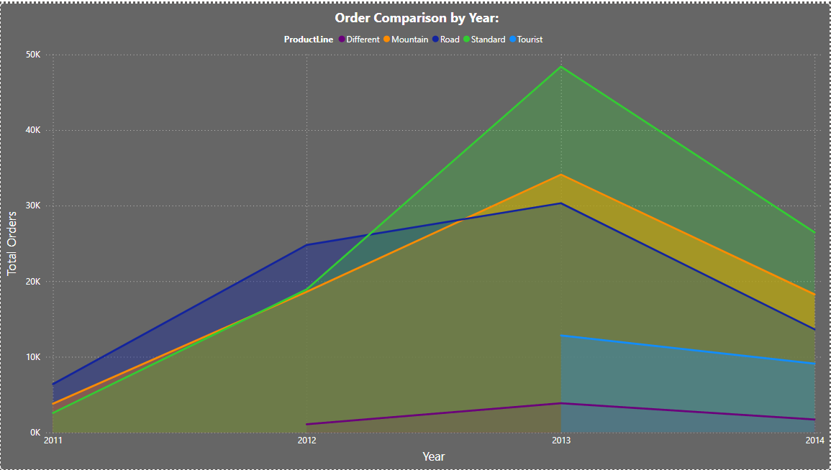
BI Dashboard to Visualize Data and Analysis

Slide 24
Question??

Slide 25


